Slide 1
Go Lang Programming
By Verrol Adams

Slide 2
Required Software Apps
Setting Go
Install Go tools from http://golang.org
Install Git
Software Version Control tool
http://git-scm.com
IDE/Editor
Microsoft Visual Studio Code with Go plugin
https://visualstudio.com/products/code-vs

Slide 3
GOPATH Directory Structure
go-lang-programming
src
github.com
work-repo
bin
pkg
GOPATH →
my-projects
bob
susan
hello
awesome
hello2
fearless
my-projects

Slide 4
Chapter 1 – Installation and Setup
Section 1
Go Tools Installation for Windows

Slide 5
Windows Installation
Download the ‘Required Software’ for your platform:
Install Git
Create a .gitconfig file in %HOME%\.gitconf:
> git config --global user.email “your@email.com”
> git config --global user.name “your name”
Install Go tools
Create GOPATH home directory
$ mkdir %HOME%\lcp
$ mkdir %HOME%\lcp\go-lang-programming
Set GOPATH env to point this directory
Install Visual Studio Code

Slide 6
Chapter 1 – Installation and Setup
Section 2
Go Tools and Plugin Setup for Mac OS X

Slide 7
Mac OS X Installation
Download the ‘Required Software’ for your platform:
Install Git
Create a .gitconfig file in $HOME/.gitconf:
$ git config --global user.email “your@email.com”
$ git config --global user.name “your name”
Install Go tools
Create GOPATH home directory
$ mkdir –p $HOME/lcp/go-lang-programming
Set GOPATH env to point this directory
Install Visual Studio Code
Install Go plugin

Slide 8
Chapter 1 – Installation and Setup
Section 3
Go Plugin Setup for Windows

Slide 9
Chapter 1 – Installation and Setup
Section 4
Go Tools and Plugin Setup for Linux

Slide 10
Linux Installation
Download the ‘Required Software’ for your platform:
Install Git
Create a .gitconfig file in $HOME/.gitconf:
$ git config --global user.email “your@email.com”
$ git config --global user.name “your name”
Install Go tools
Create GOPATH home directory
$ mkdir –p $HOME/lcp/go-lang-programming
Set GOPATH env to point this directory
Install Visual Studio Code
Install Go plugin

Slide 11
Chapter 2 – The Basics
Section 1
Getting To Know Go (golang)

Slide 12
Objectives
What is Go?
Why Learn Go?

Slide 13
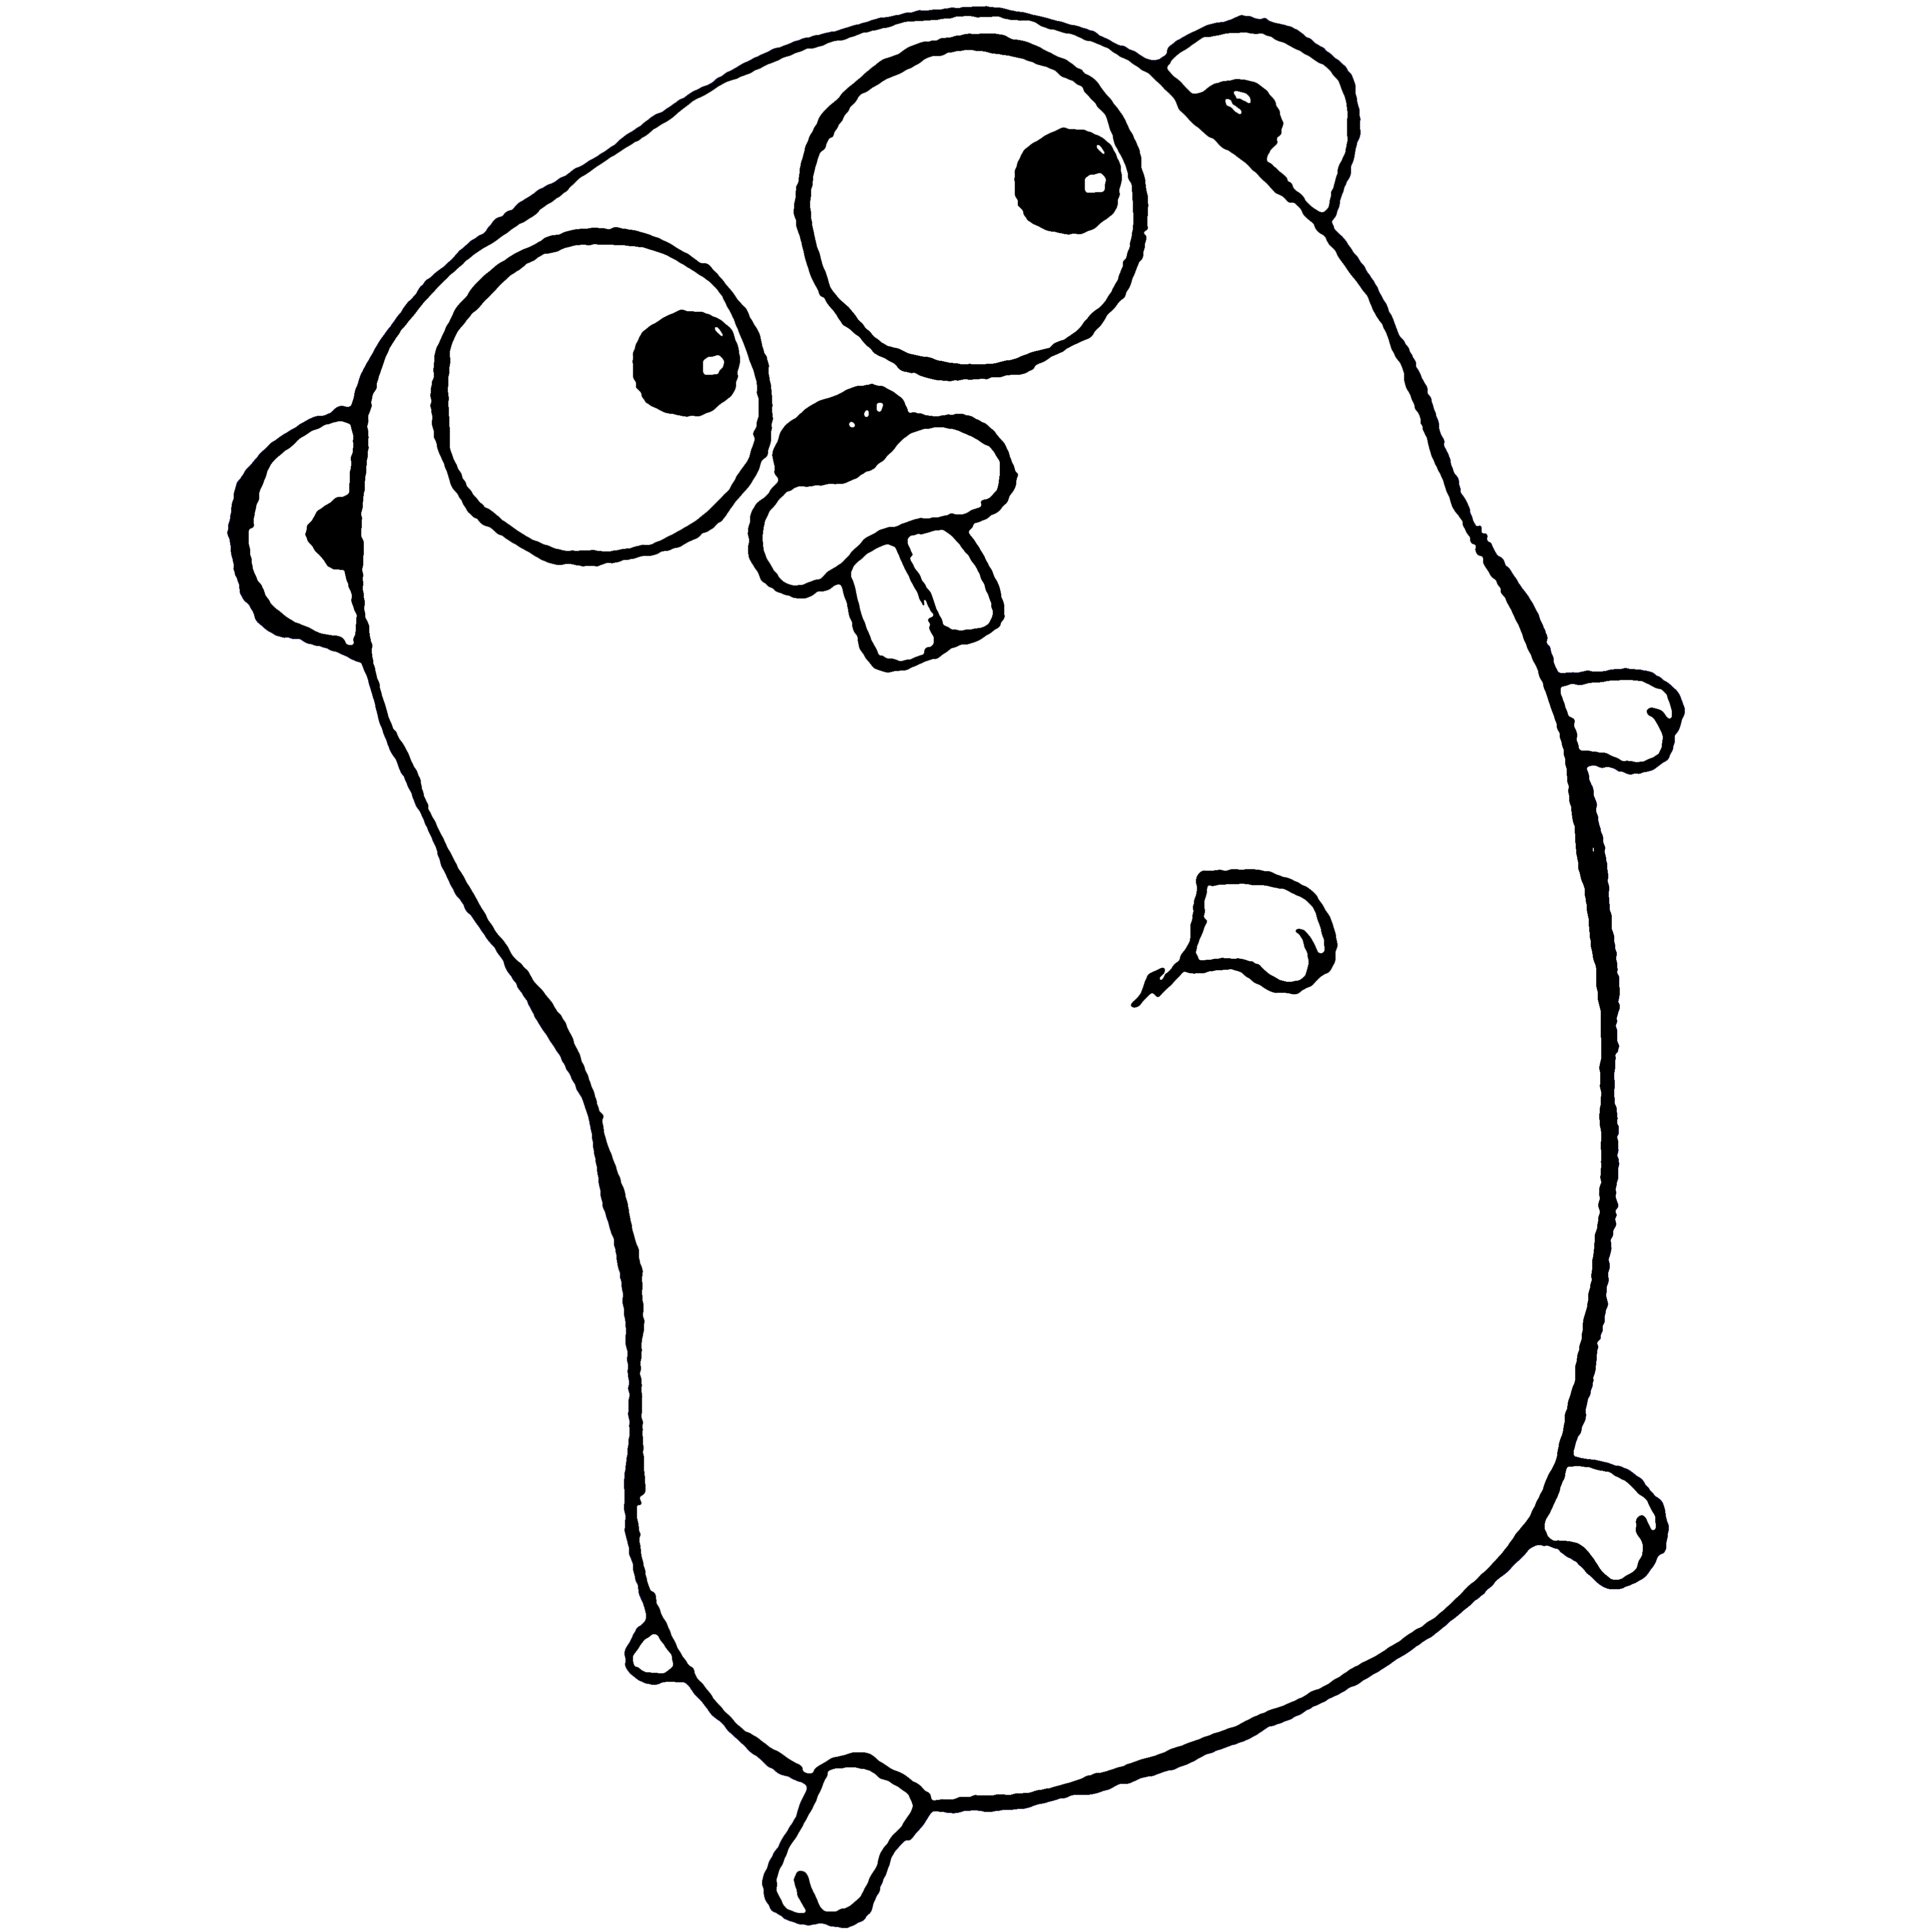
Go (golang) Mascot

Slide 14
What is Go?
From http://golang.org:
Go is an open source programming language that makes it easy to build simple, reliable, and efficient software.
From Wikipedia ():
Go (often referred to as golang) is an open source programming language created at Google in 2007 by Robert Griesemer, Rob Pike, and Ken Thompson. It is a compiled, statically typed language in the tradition of Algol and C, with garbage collection, limited structural typing, memory safety features and CSP-style concurrent programming features added.
The language was announced in November 2009; it is used in some of Google's production systems, as well as by other firms. Two major implementations exist: Google's Go compiler, "gc", is developed as open source software and targets various platforms including Linux, OS X, Windows, various BSD and Unix versions, and since 2015 also mobile devices, including smartphones.

Slide 15
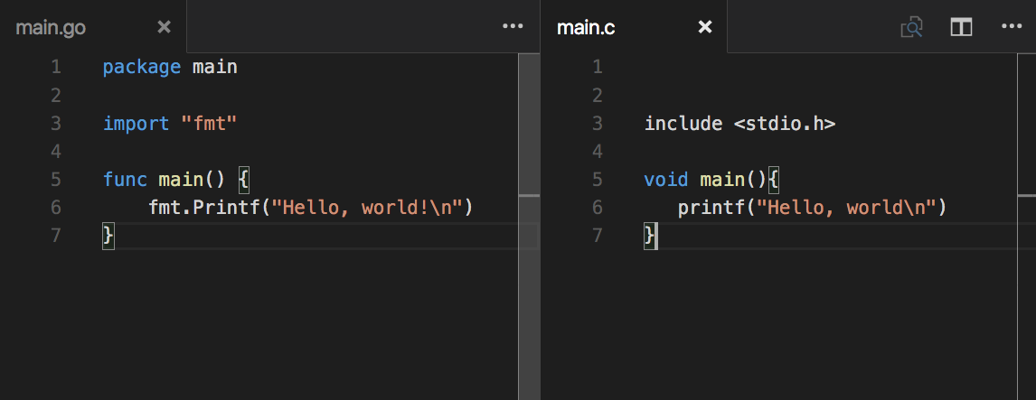
Go and C Compared

Slide 16
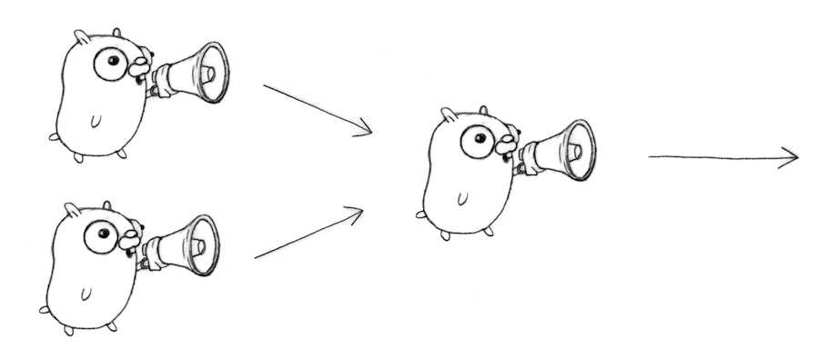
CSP: (Communicating Sequential Processes)

Slide 17
Why Learn Go?
Great talking point at your next geek party
One of the new coolest things to do
Job security
In existing job
In looking for new opportunities
Fun
A different way of thinking about software
Makes a lot of hard stuff, easier

Slide 18
Chapter 2 – The Basics
Section 2
Writing, Compiling, and Running Go Code

Slide 19
Objectives
General Structure of a Go Program
Package
Importance of the “main” package
imports
Program entry point
The “main” function
Using the ‘go’ tool chain
Compiling your program
Building an executable
Installing an executable
Running your programming

Slide 20
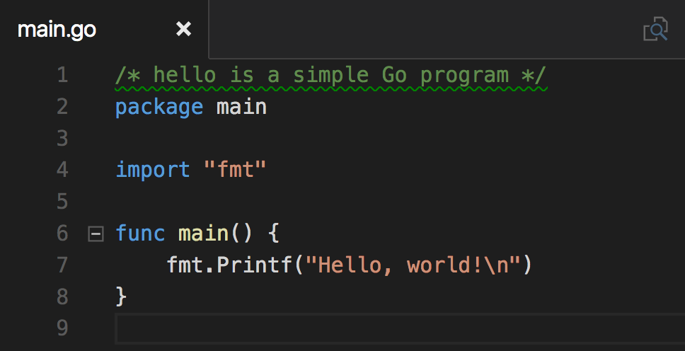
Minimalist Go Program

Slide 21
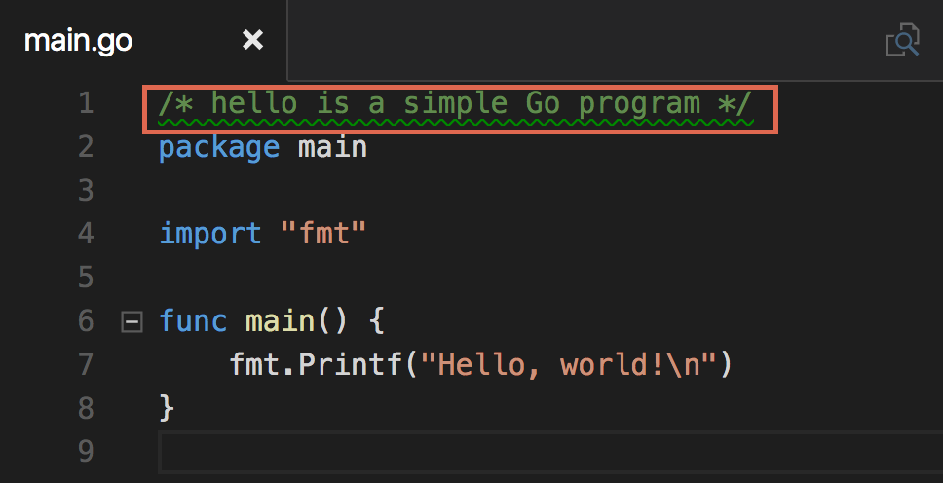
Comments

Slide 22
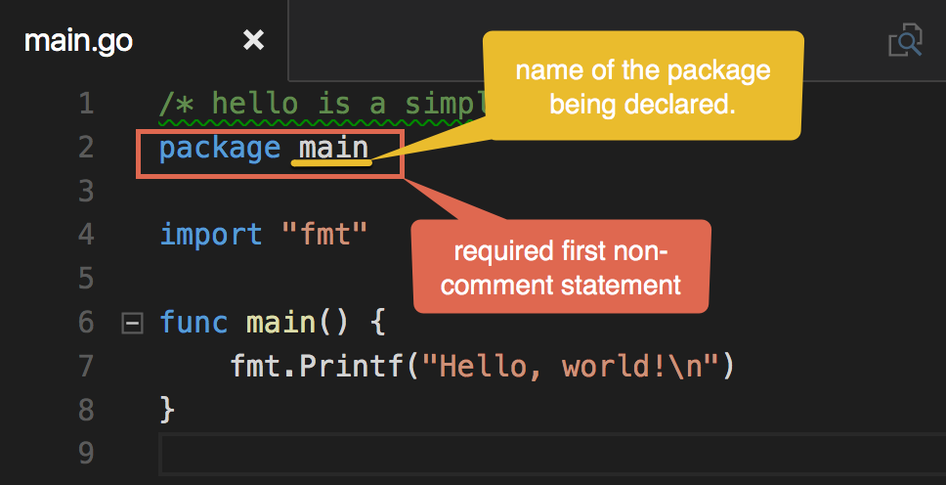
Package

Slide 23
Executable or Package
All Go source code belongs to either a package or an executable/application
A package provides reusable code in functions, types, methods, etc.
An executable/application is the only thing that can be invoked or be started by the operating system
An executable/application uses one or more package(s)

Slide 24
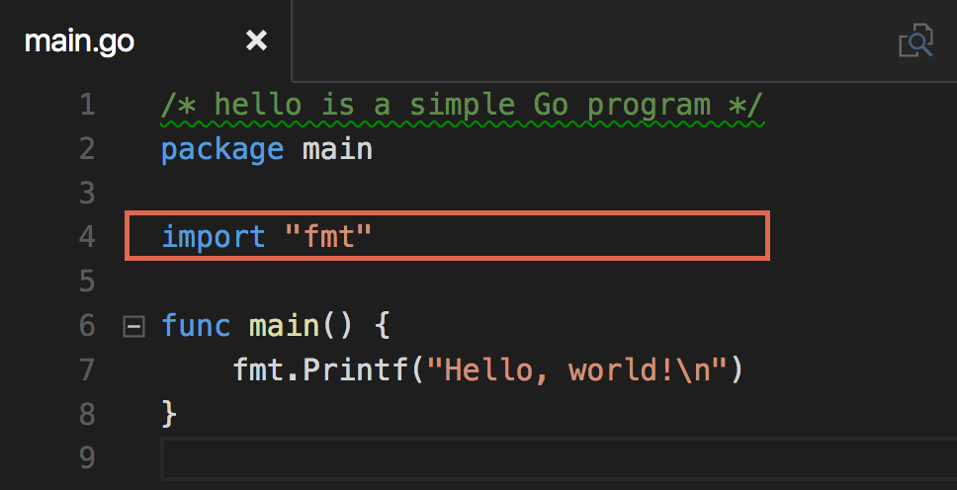
Import

Slide 25
An Hypothetical Program

Slide 26
Program Entry Point
First line
Agreed
function

Slide 27
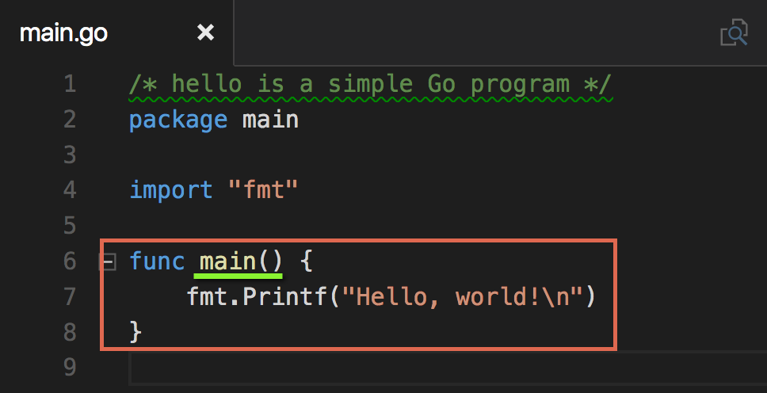
Main Function

Slide 28
Awesomely Complex Program
Package : task
Package : a
Package : main
Print()
Read()
main()
Write()

Slide 29
Using the “go” tool chain
Task | Command | Example
Run the source for an executable | ‘go run’ | ‘go run [file.go …]’
Compile source to an executable ‘main’ | ‘go build’ | ‘go build [file.go …]’
Install executable or package into $GOPATH/bin or $GOPATH/pkg | ‘go install’ | ‘go install’ or ‘go install <path>’
Format Go code | ‘gofmt’ | ‘gofmt <file.go>’
Manage imports | ‘goreturns’ | ‘goreturns <file.go>’
Get documentation | ‘go doc [package]’ or ‘godoc [package]’ | ‘go doc fmt’ and ‘godoc fmt’

Slide 30
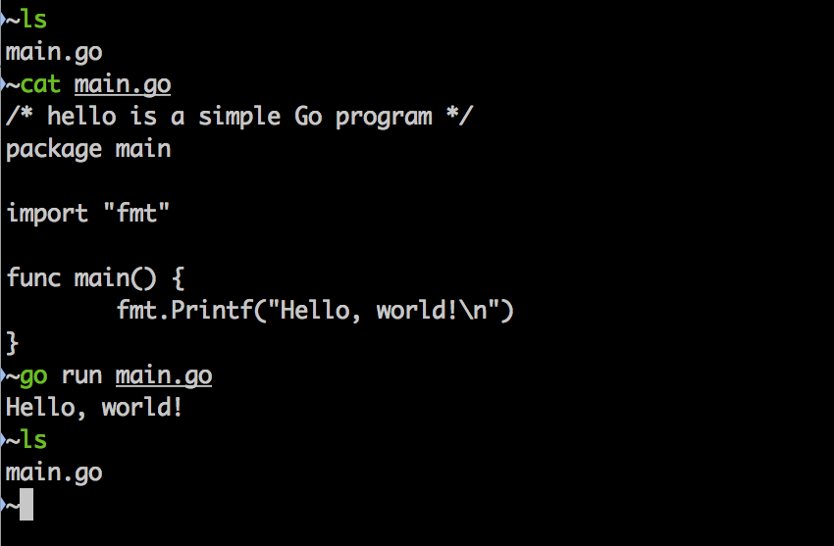
Compiling & Running

Slide 31
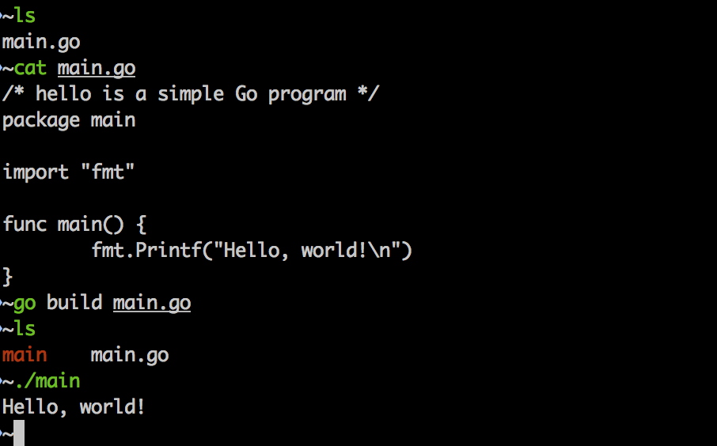
Building – Creating an Executable

Slide 32
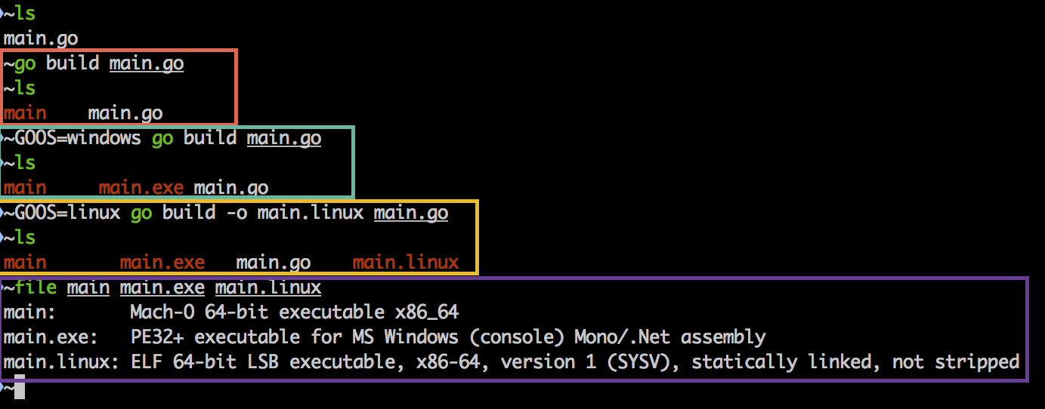
Cross Compiling/Building

Slide 33
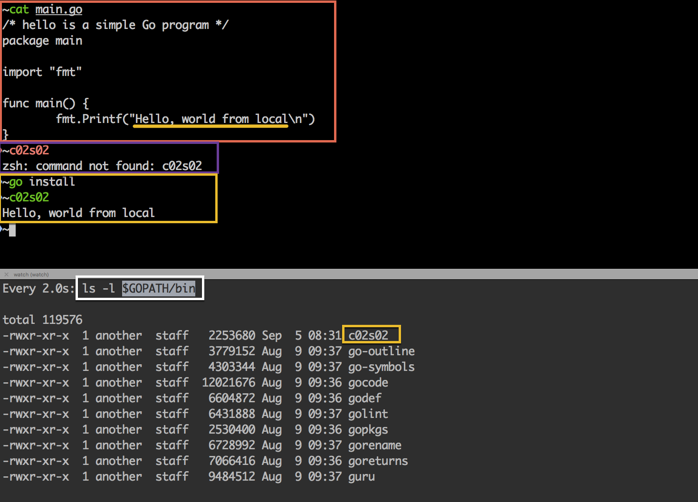
Installing Application (local)

Slide 34
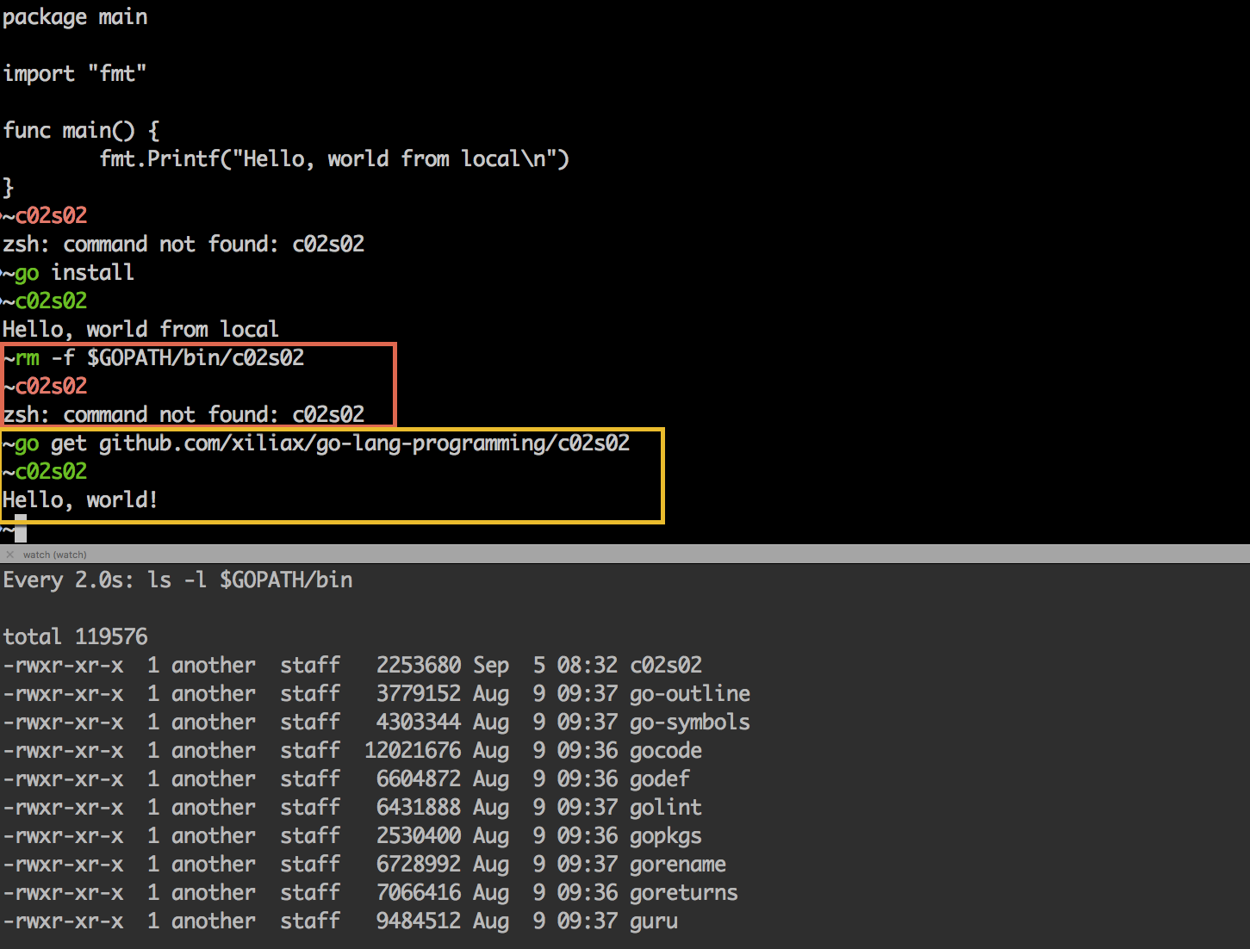
Installing Application (remote)

Slide 35
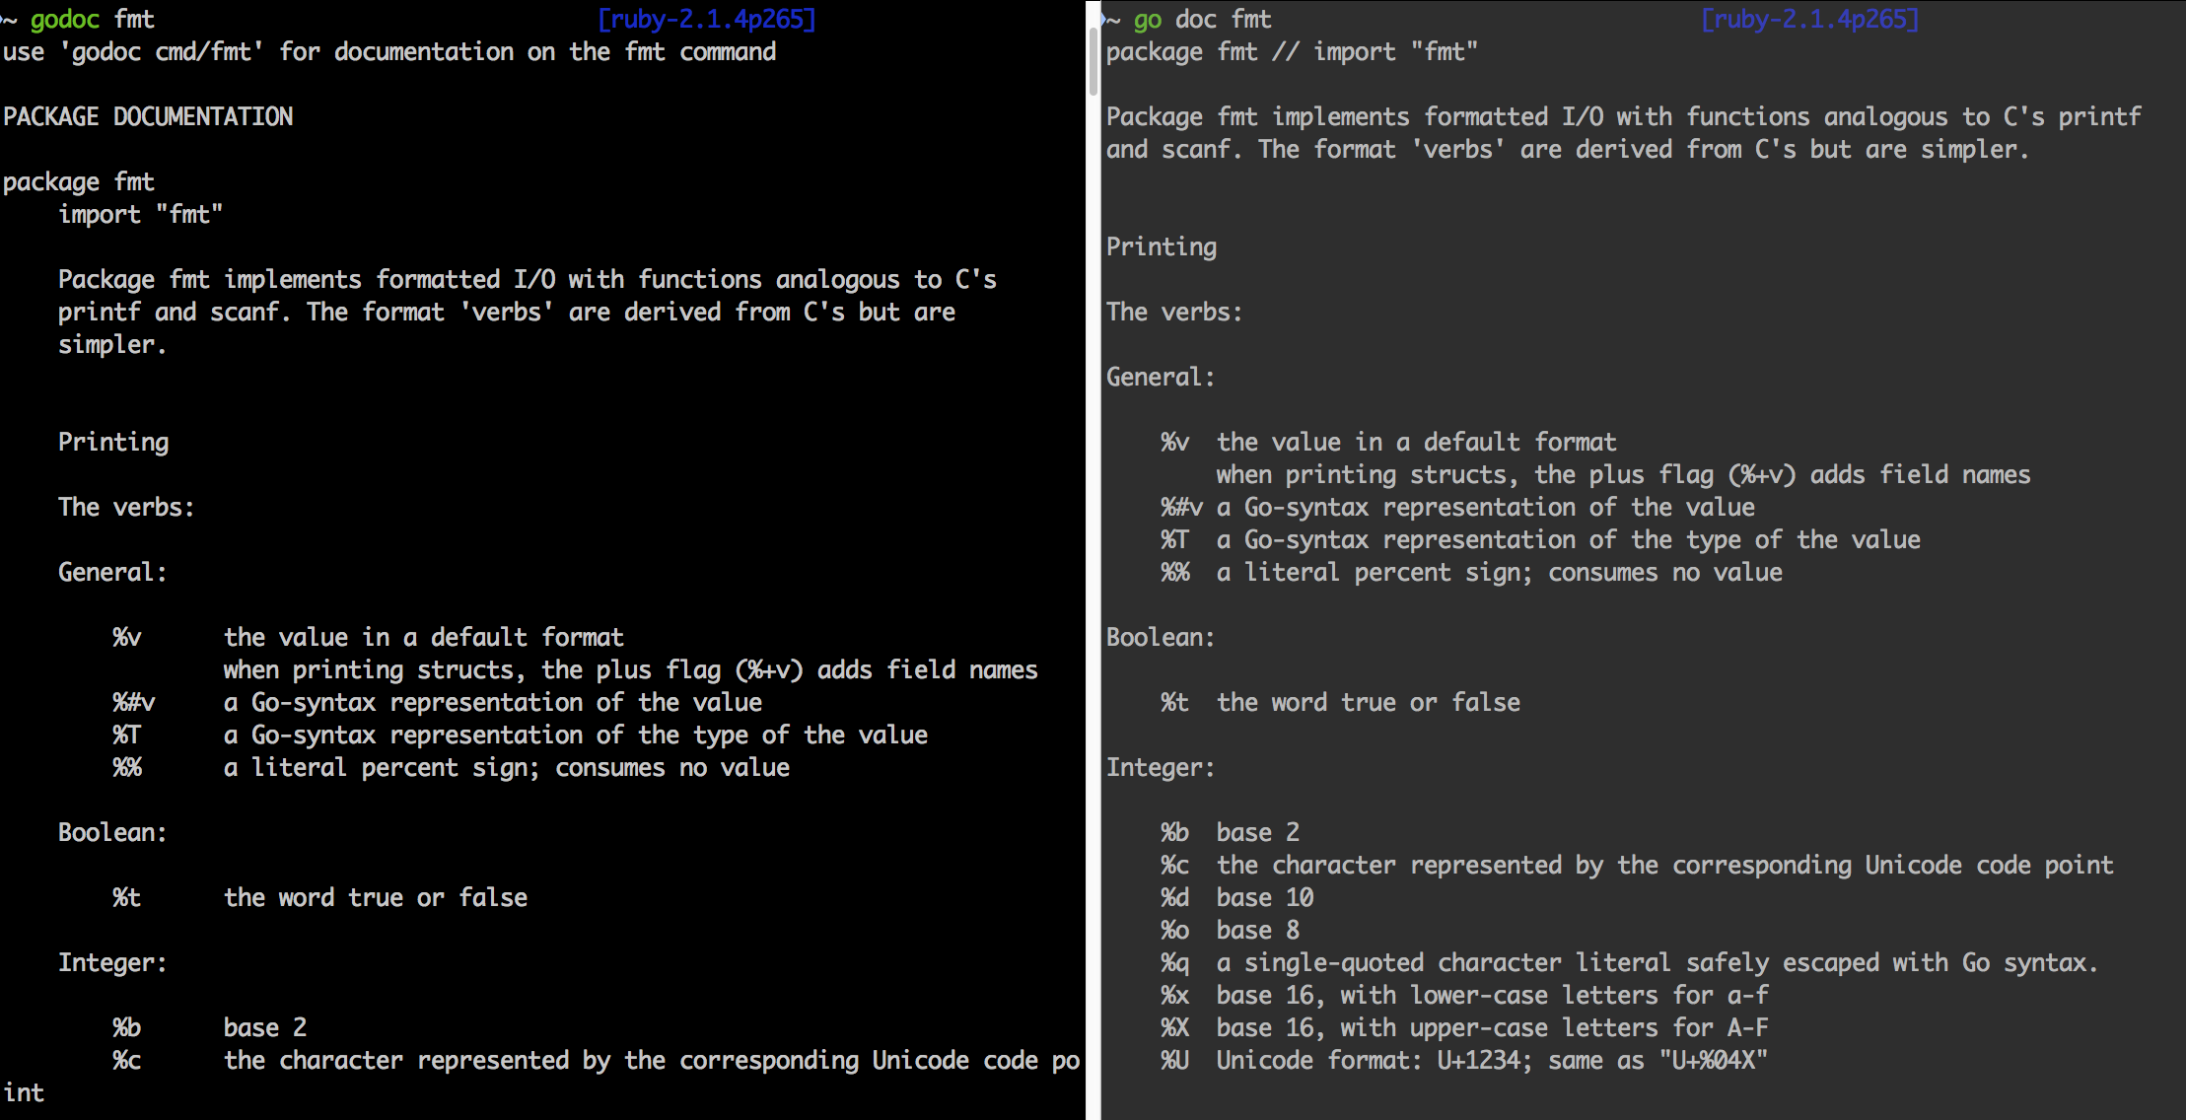
Package Documentation

Slide 36
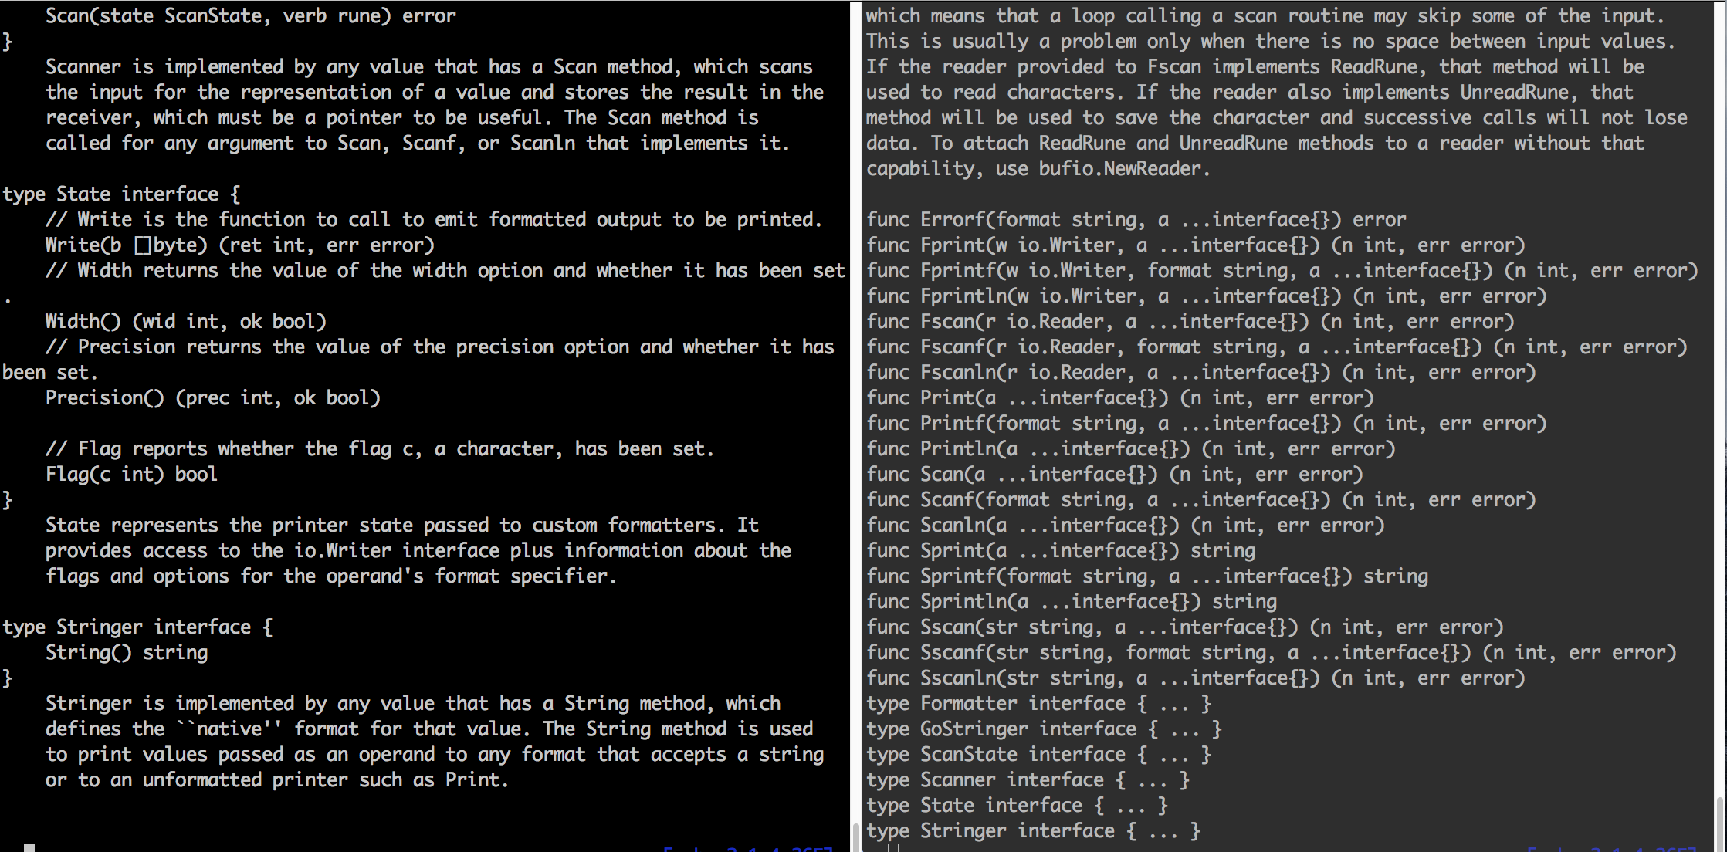
‘godoc’ vs ‘go doc’

Slide 37
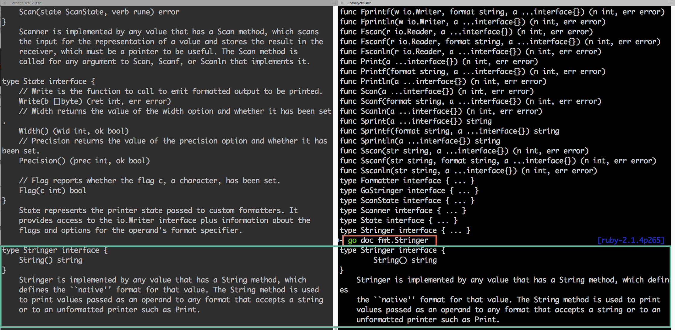
‘go doc fmt.Stringer’

Slide 38
Chapter 2 – The Basics
Section 3
Values, Bits, and Numbers

Slide 39
Objectives
Playing with Values
Bytes
Integers
Strings
Booleans
Arrays
Maps
Data Type and Storage (some)

Slide 40
Definition: Value
What is a ‘value’?
Verrol’s definition:
A value is an abstraction to represent a computed result
Not all values computed, some values just represents themselves. When a value stands for itself, we call it a literal. NOTE, a literal is still a value.
Examples:
6
6 is a value and also a literal, it stands for itself
3 + 1
will compute the value 4, but we don’t see for here
3.141592
“Verrol”
“Verrol” is a string literal, it is not a computed value, but still a value
true
true is also a literal in Go Language.

Slide 41
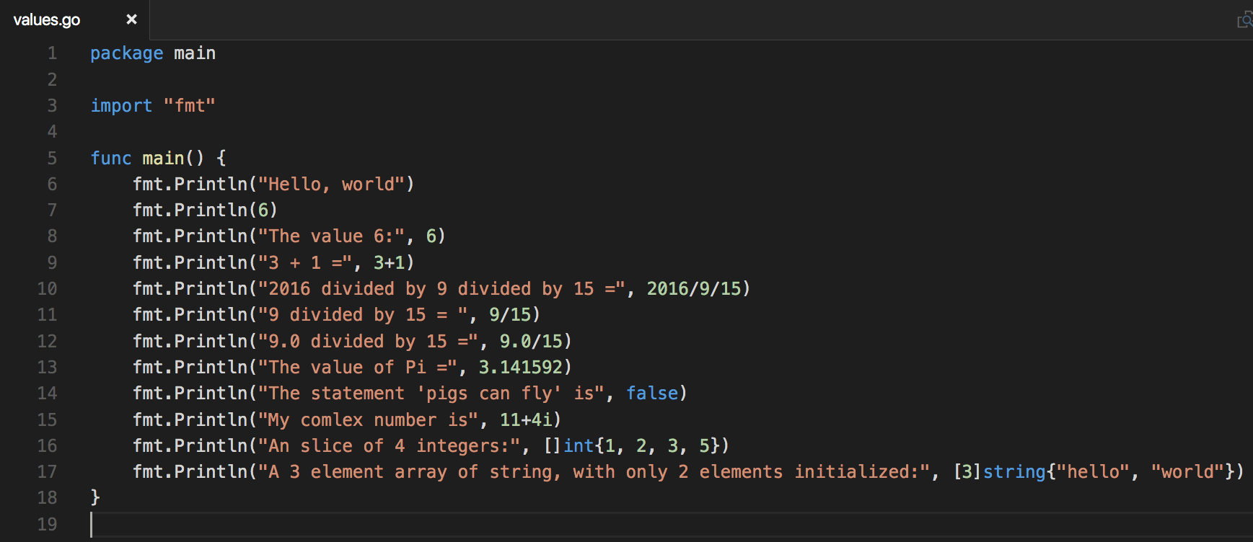
Playing with values

Slide 42
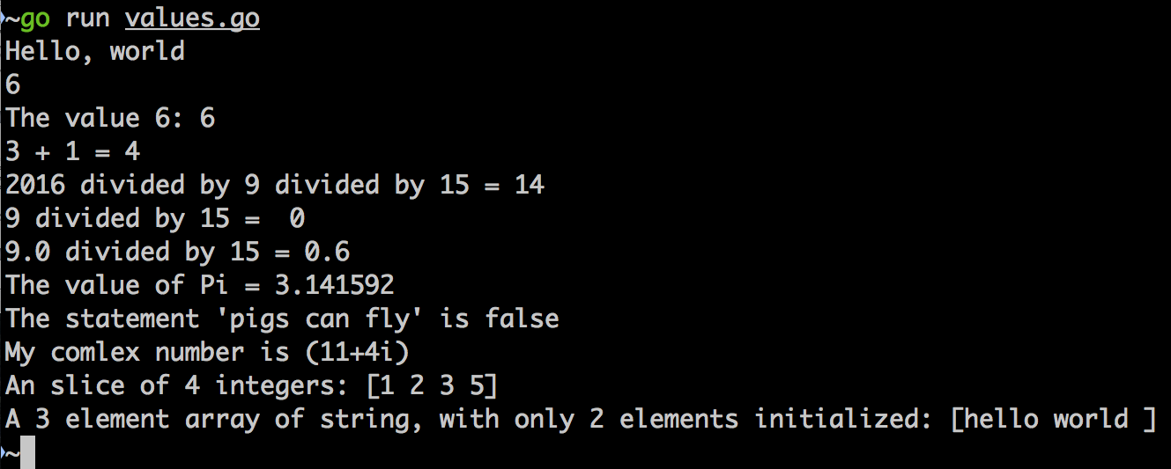
Demo

Slide 43
Everything is a Number
Everything typed into a computer is a character
Every character is represented by a number
A number is build up bit by bit, quite literally

Slide 44
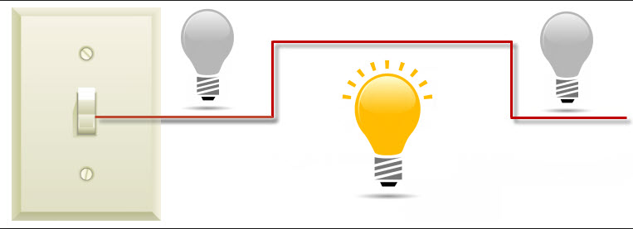
What is a ‘bit’?
Bit
A bit, is like a switch, it is either on or off
Each bit represents a binary value of 0 or 1
1
0
0

Slide 45


Counting with ‘bits’
Just as 1 bit can designate 2 distinct states or values, using multiple bits can designate even higher numbers of states/values.
A pair of light bulbs, can have 4 distinct states. Hence, 2 bits can designate 4 distinct states/values.

Slide 46
Bit Grouping Illustrated
Individual bits
…
Named grouping
…
Index:
bit’s location in group
0
1
6
7
MSB
LSB
Consider writing the decimal value for ‘one thousand two hundred and eight’:
Big Endian (left-to-right): 1 – 2 – 0 – 8
Little Endian (right-to-left): 8 – 0 – 2 – 1
NOTE: The most-significant-digit in big endian is on the left, while it is the right for little endian.

Slide 47
Grouping Bits
Grouping bits to represents numbers
4 bits = nibble
8 bits = byte
16 bits
32 bits
64 bits
most modern computers use this many bits for addressing
128 bits
Depends on programming language
and sometimes processor

Slide 48
Binary Number System
The ‘binary numbering system’ uses bits to represent numbers.
Since a certain number of bits allows us to represent a distinct number of states, we can choose to represent either positive or negative numbers.
To represent a negative number, we designate the MSB as the ‘sign bit’.
The ‘sign bit’ tells us if the number is positive or negative.

Slide 49
Signed and Unsigned Bits
Given a group of 4 bits, we can either:
Use all 4 bits as ‘unsigned bits’ to represent numbers:
Use 1 bits as the ‘sign bit’, s-bit, and the remaining bits to represent the value of the number:
x
x
x
x
Unsigned bits grouping
s
x
x
x
Signed bits grouping

Slide 50
Signed and Unsigned Bits: Illustrated
Unsigned Bits | Unsigned Value | Signed Bits | Signed Value
000 | 0 | 0-00 | 0
001 | 1 | 0-01 | 1
010 | 2 | 0-10 | 2
011 | 3 | 0-11 | 3
100 | 4 | 1-00 | 0
101 | 5 | 1-01 | -3
110 | 6 | 1-10 | -2
111 | 7 | 1-11 | -1
* Wikipedia: https://en.wikipedia.org/wiki/Signed_number_representations

Slide 51
Bit Grouping and Numeric Range
# of bits | # of unique values | Unsigned Number Range | Signed Number Range
8 | 2^8 = 256 | 0 to 255 | -127 to 127
16 | 2^16 = 65,535 | 0 to 65,534 | -32,767 to 32,767
32 | 2^32 = 4,294,967,295 | 0 to 4,294,967,294 | -2,147,483,647
64 | 2^64 = 18,446,744,073,709,551,615 | 0 to 18,446,744,073,709,551,614 | -9.22337203685478E18 to 9.22337203685478E18

Slide 52
Memory (simplified)
A mechanism or device for storing bytes
Memory capacity is measured in number of bytes
bytes
bits

Slide 53
Memory (addressing)
Question:
If my storage device can store X bytes, how do I access a particular byte?
Answer:
Addressing; each byte has it own address
bytes
0
1
2
3
4
…
# of bytes | Name
1024 | 1kilo-bytes (1Kb)
1024*1024 | 1mega-bytes (1Mb)

Slide 54
Storing Information Compared
Literature | Computer
Books | Programs
Chapters | Packages/Modules
Sections | Sub-packages/Sub-modules*
Paragraphs | Functions
Sentences | Statements
Words | Tokens
Characters | Characters
Letter, Number, Symbol | Letter, Number, Symbol
- | Bits
*https://golang.org/pkg/

Slide 55
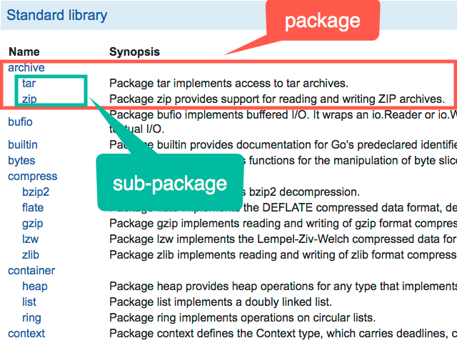

Slide 56
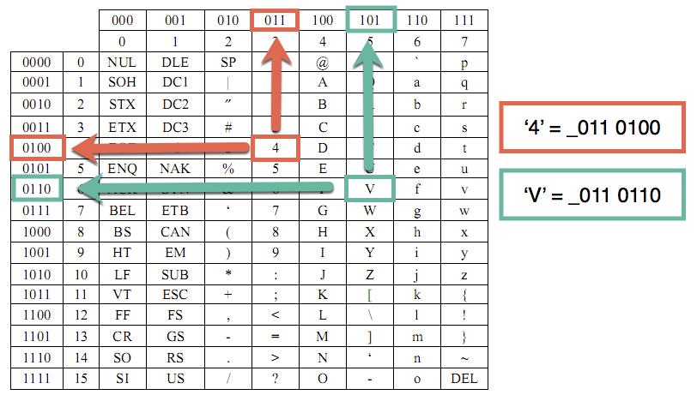
ASCII
A system for defining the letters, numbers , and symbols for groups of 8-bits (byte) values

Slide 57
Chapter 2 – The Basics
Section 4
Data and Data Types

Slide 58
Objectives
Understanding Data Types
Numbers
Byte
Rune
Integer
Float
Complex
Booleans
Strings
Data Type Storage (simplified)

Slide 59
ASCII
A system for defining the letters, numbers , and symbols for groups of 8-bits (byte) values
ASCII is only one of many encoding standards. Go Lang uses utf-8, which supports 8, 16, 24, and 32-bits encoding.

Slide 60
Values
Column 1
5
19
Verrol
true
false
3.14159
13.87
9/11/2001
Column 2
5e19
0.085
solid
orange
A
B
J
5 + 7i

Slide 61
Categorizing Values
Column 1
5
19
Verrol
true
false
3.14159
13.87
9/11/2001
Column 2
5e19
0.085
solid
orange
A
B
J
5 + 7i
5, 19, 5e19
3.14159, 13.87, 0.085
true, false
Verrol, solid, orange
A, B, j
9/11/2001
5 + 7i

Slide 62
Definition: Data & Data Type
What is ‘data’?
‘data’ is another name for ‘value’
The words ‘data’ and ‘value’ can be used interchangeably
What is ‘data type’?
Verrol’s definition:
A ‘data type’ is the formal specification of the interpretation and representation of a value
In other words, a value of a certain type must meet all the characteristics of the type
A type defines which operations are valid
Examples of types:
integer
float
boolean
String
Date
Complex

Slide 63
Example of Using Types
Type | OK | Error
uint8 | 8 + 16 | 8 + “16”
float64 | 3.1415 + 9 | 3.1415 + true
int32 | 1093890 | 243801 / “a10b5”
boolean | true || false | true + false
string | “hello” + “, “ + “ world” | “hello” * 6

Slide 64
Memory (addressing)
Question:
If my storage device can store X bytes, how do I access a particular byte?
Answer:
Addressing; each byte has it own address
bytes/data
address
0
1
2
3
4
…
# of bytes | Name
1024 | 1kilo-bytes (1Kb)
1024*1024 | 1mega-bytes (1Mb)

Slide 65
Memory Device (simplified)
0
1
0
…
1
1
1
Memory
Device
x
x
x
…
x
x
x
address
…
…
data/bytes
…
control

Slide 66
Reading/Writing Data
# of bits | # of bytes | 8-bits device | 16-bits device | 32-bits device | 64-bits device
8 | 1 | 1 | 1 | 1 | 1
16 | 2 | 2 | 1 | 1 | 1
32 | 4 | 4 | 2 | 1 | 1
64 | 8 | 8 | 4 | 2 | 1
* Number of operations to read/write data of various sizes

Slide 67
Memory Device (simplified)
0
1
0
…
1
1
1
Memory
Device
x
x
x
…
x
x
x
address
…
…
data/bytes
…
control
r/w
Access size (1, 2, 4, 8 bytes)

Slide 68
Boolean Data Type in Memory (illustration only)
Since a boolean value represents either ‘true’ or ‘false’, it can fit into byte or 8-bits
Assume that
‘false’ is represented by the numeric value 0
‘true’ is represented by the numeric value 1
3 boolean values in memory might look like:
1-byte
x
0
x
x
0
1
x
x
address
…
10
11
12
13
14
15
16
false
false
true

Slide 69
Byte Data Type in Memory (illustration only)
Since a ‘byte’ by definition is 8-bits, any value using 8-bits can be stored in a byte
Assume that the following values are to be stored in memory:
The value 0 can fit in a byte (signed or unsigned)
The value 120 can fit in a byte (signed or unsigned)
The value -10 can fit in a ‘signed byte’
The value 255 can fit in an ‘unsigned byte’
1-byte
x
0
x
x
120
-10
x
255
address
…
10
11
12
13
14
15
16
interpreted
value
0
120
-10
-10

Slide 70
Integer (2-bytes)Data Type in Memory (illustration only)
2-bytes can represent:
‘signed’ numbers -32,767 to 32,767
‘unsigned’ numbers 65,534
The following values can all be stored in 2-bytes, either signed or unsigned as appropriate:
0, 54986, -10, and -32012
2-byte
0
54986
-10
-32012
x
address
10
11
12
13
14
15
16
17
18

Slide 71
String Data Type in Memory (illustration only)
Imagine strings are stored as:
[length (32-bits) | utf-8 characters]
The string “verrol” has 6 elements:
‘v’, ‘e’, ‘r’, ‘r’, ‘o’, and ‘l’
utf-8(1-byte)
x
6
‘v’
‘e’
‘r’
‘o’
‘l’
x
address
…
10
14
15
16
17
18
19
The string “世界” has 2 elements:
‘世’, and ‘界’
utf8(3-bytes)
x
2
‘世’
‘界’
x
address
…
10
14
17
20

Slide 72
Chapter 2 : The Basics
Section 5 – Constants and Variables

Slide 73
Objectives
Defining and Using Constants
Defining and Using Variables

Slide 74
Basic Data Types
bool
string
Numeric types:
uint either 32 or 64 bits
int same size as uint
uintptr an unsigned integer large enough to store the uninterpreted bits of a pointer value
uint8, uint16, uint32, uint64
int8, int16, int32, int64
float32 the set of all IEEE-754 32-bit floating-point numbers
float64 the set of all IEEE-754 64-bit floating-point numbers
complex64 the set of all complex numbers with float32 real and imaginary parts
complex128 the set of all complex numbers with float64 real and imaginary parts
byte alias for uint8
rune alias for int32 (represents a Unicode code point)

Slide 75
Definition: Value
What is a ‘value’?
Verrol’s definition:
A value is an abstraction to represent a computed result
Not all values computed, some values just represents themselves. When a value stands for itself, we call it a literal. NOTE, a literal is still a value.
Examples:
6
6 is a value and also a literal, it stands for itself
3 + 1
will compute the value 4, but we don’t see for here
3.141592
“Verrol”
“Verrol” is a string literal, it is not a computed value, but still a value
true
true is also a literal in Go Language.

Slide 76
Definition: Constant
What is a ‘constant’?
Verrol’s definition:
A constant a named used in place of a value
Property:
The value of a constant can’t be changed after it is assigned
Examples:
pi
Used instead of the value 3.14
secondsInHour
Used instead of the value 60
hoursInDay
Used instead of the value 24
presenterName
Used instead of the value “Jane Doe”
favoriteLanguage
Used instead of the value “Go Language”

Slide 77
Syntax: Constant
How do you define a ‘constant’?
Formal Syntax:
const name/identifier [type] = value
Examples:
const pi float32 = 3.14
const secondsInMinute uint8 = 60
const hoursInDay uint = 24
const presenterName string = “Jane Doe”
Type Inferred Syntax:
const name/identifier = value
Examples:
const pi= 3.14
const secondsInMinute = 60
const hoursInDay = 24
const favoriteLanguage = “Go Language”

Slide 78
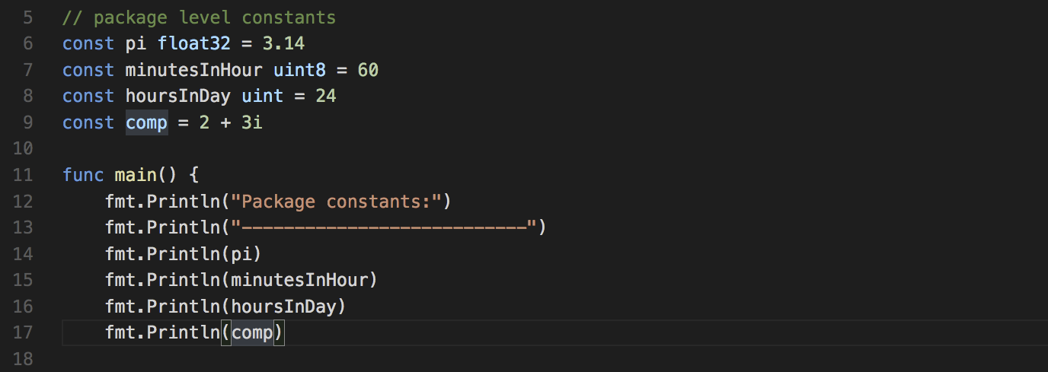
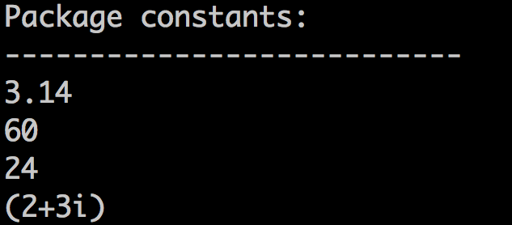
Example : constant/main.go

Slide 79
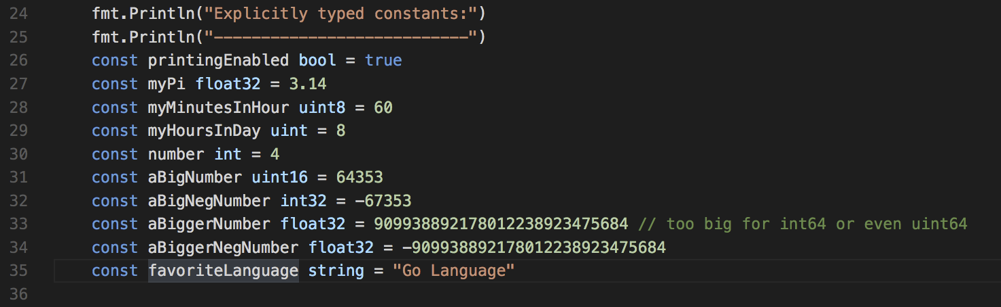
Explicit Typed Constants

Slide 80
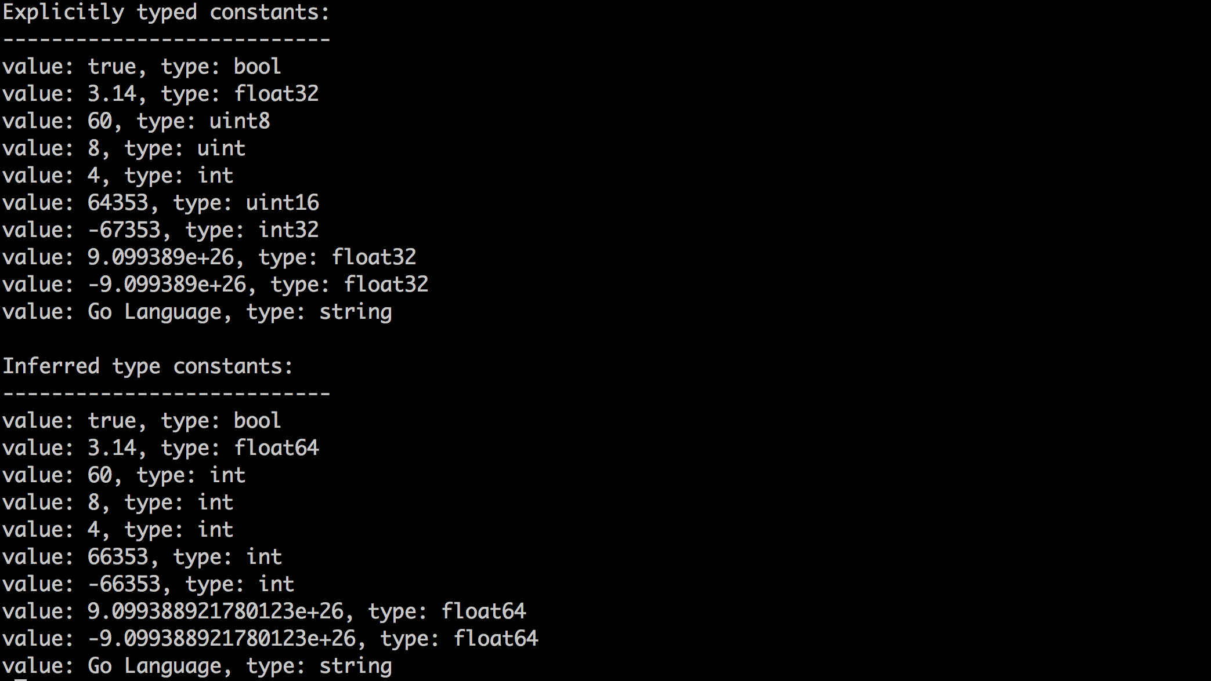
Explicit vs Inferred Type Constant

Slide 81
Definition: Variable
What is a ‘variable’?
Verrol’s definition:
A variable is a named abstraction to recall or reference a value
A variable can be used anywhere a value is required/expected.
We use variables to tag/associate data in memory
Property:
Variables can change their values over the life of the program
Examples:
itemCount
price
myName
isLoggingEnabled

Slide 82
Syntax: Variable
How do you define a ‘variable’?
Formal Syntax:
var name/identifier [type] = value
Examples:
var itemCount uint = 537
var price float32 = 235.87
var myNme string = “Verrol”
var isLoggingEnabled bool = false
Type Inferred Syntax:
var name/identifier = value
Examples:
var itemCount = 537
var price = 235.87
var myNme = “Verrol”
var isLoggingEnabled = false

Slide 83
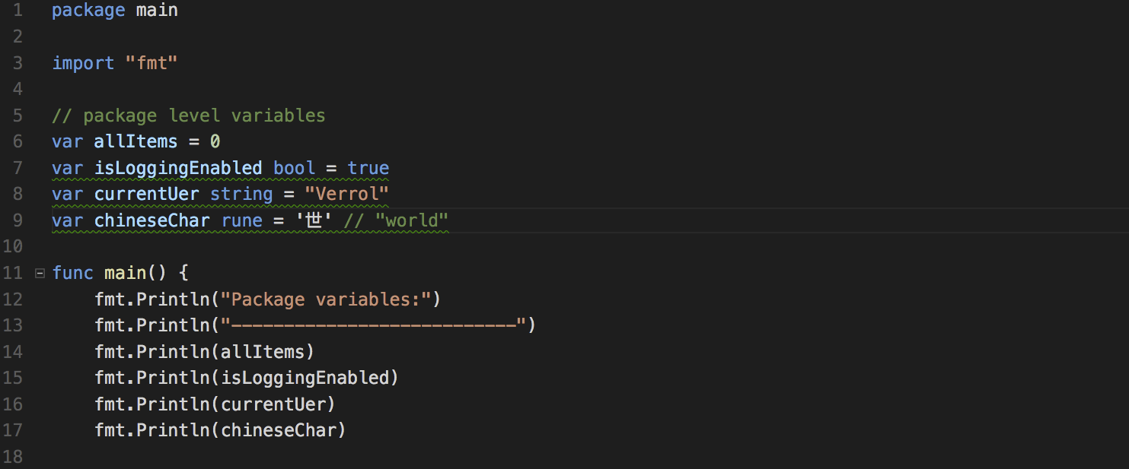
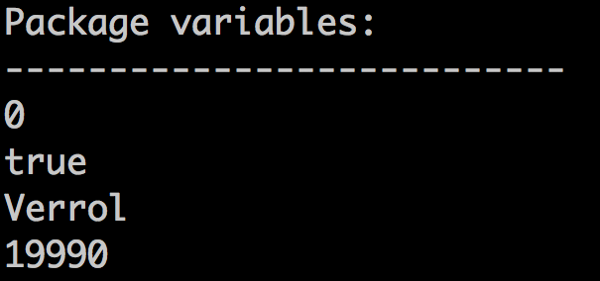
Example: variable/main.go

Slide 84
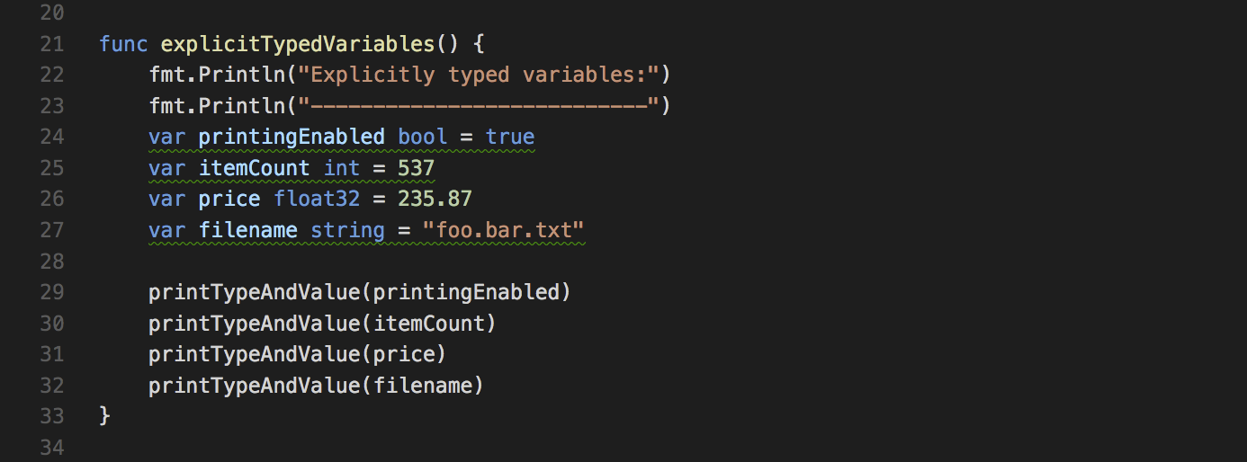
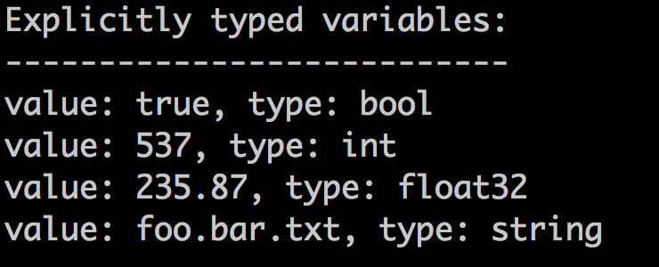
Explicitly Typed Variable

Slide 85
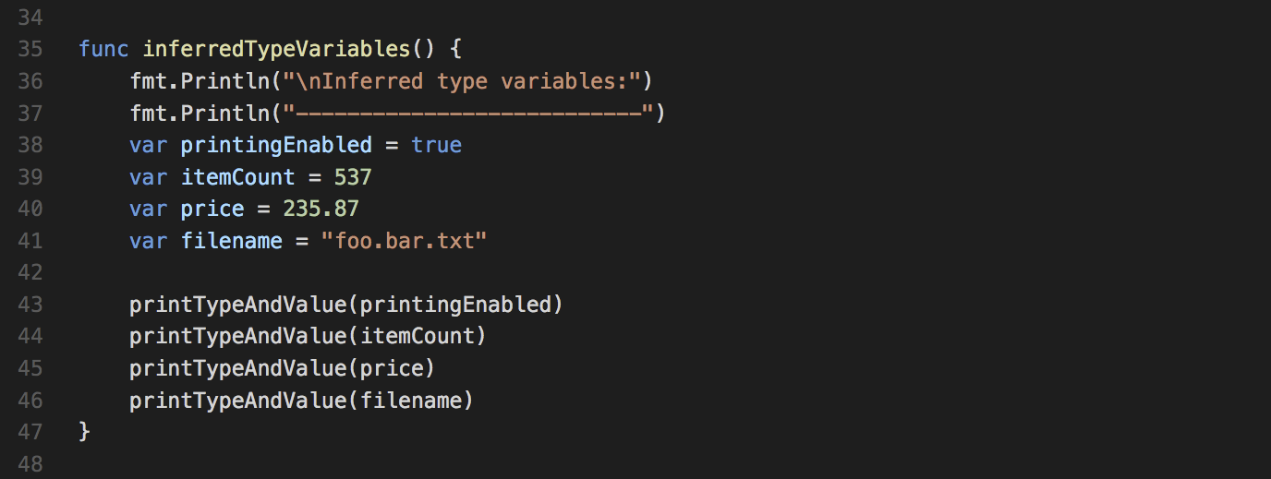
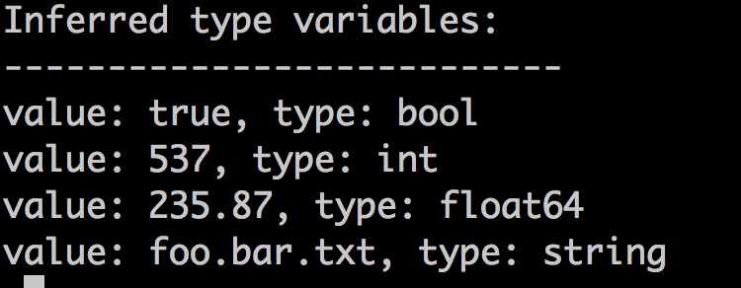
Inferred Type Variable

Slide 86
Constants and Variables in Memory
data
0
10
address
20
30
const/var | Address | Type
price | 0 | float64
flag | 8 | boolean
count | 10 | int32
message | 14 | string
name | 34 | string

